Slide 1

Effect of COVID-19
Team 5
Team members:
Yuanying Li, Chen Liang, Ketaki Joshi, Chenang Zhang

Slide 2

We focused on:
01
02
03
Current situation about COVID-19
Effect of COVID-19 on road transportation in California State
Effect of COVID-19 on fatal car accidents

Slide 3

Research Goals
By combining Python and statistics knowledge, we wanted to understand the current situations about the COVID-19, find out the effect on-road transportation, and predict the number of people is saved in fatal car accidents in California.

Slide 4
Research questions
1. What is the number of confirmed cases, deaths, recoveries, and active cases globally?
2. Prominently affected countries by COVID-19
3. Current situation in the USA
4. Which county in California has the largest vehicle miles traveled? Which county has the shortest?
5. Whether shelter in place order reduced the vehicle miles traveled during the COVID-19 period in California?
6. By how many percent the average vehicle miles traveled in California was dropped after the shelter in place order was implemented?
7. How will the decline in VMT affect the number of fatal accidents in California?
8. How many numbers of people saved?

Slide 5
Datasets and Methods chosen
Part I: Exploratory data analysis using plotly package
（Novel Coronavirus (COVID-19) Cases datasets are provided by JHU CSSE.）
Part II: Hypothesis test, level of significance (alpha = 0.05)
（The United States vehicle miles traveled dataset is from StreetLight, a transportation analytics firm.）
Part III: A time-series regression to predict the fatal car accident after April 2020
（The historical fatal car accidents dataset is from the United States federal goverment.）

Slide 6
Current situation about COVID-19
01

Slide 7
Research questions
1. What is the number of confirmed cases, deaths, recoveries, and active cases globally?
2. Prominently affected countries by COVID-19
3. Current situation in the USA
4. Which county in California has the largest vehicle miles traveled? Which county has the shortest?
5. Whether shelter in place order reduced the vehicle miles traveled during the COVID-19 period in California?
6. By how many percent the average vehicle miles traveled in California was dropped after the shelter in place order was implemented?
7. How will the decline in VMT affect the number of fatal accidents in California?
8. How many numbers of people saved?

Slide 8
THE PANDEMIC
???
4,347,921
297,220
Let’s refresh our memory with some general data about the virus
Worldwide cases
Deaths

Slide 9
Current Situation of COVID-19
Part 1 Code

Slide 10
Effect of COVID-19 on
Vehicle Miles Traveled
02

Slide 11
Research questions
1. What is the number of confirmed cases, deaths, recoveries, and active cases globally?
2. Prominently affected countries by COVID-19
3. Current situation in the USA
4. Which county in California has the largest vehicle miles traveled? Which county has the shortest?
5. Whether shelter in place order reduced the vehicle miles traveled during the COVID-19 period in California?
6. By how many percent the average vehicle miles traveled in California was dropped after the shelter in place order was implemented?
7. How will the decline in VMT affect the number of fatal accidents in California?
8. How many numbers of people saved?

Slide 12
Exploratory Analysis
 | County name | Date | VMT (miles)
Maximun | Los Angeles | 2020-03-06 | 275,000,000
Minimum | Trinity | 2020-04-05 | 17,000
On March 19, 2020, California became the first state in the nation to declare a statewide shelter in place.

Slide 13
The percentage VMT dropped
California statewide
Trinity County
Santa Clara County
Los Angeles County
dropped 68.76%
dropped 45.12%
dropped 79.38%
dropped 70.33%

Slide 14
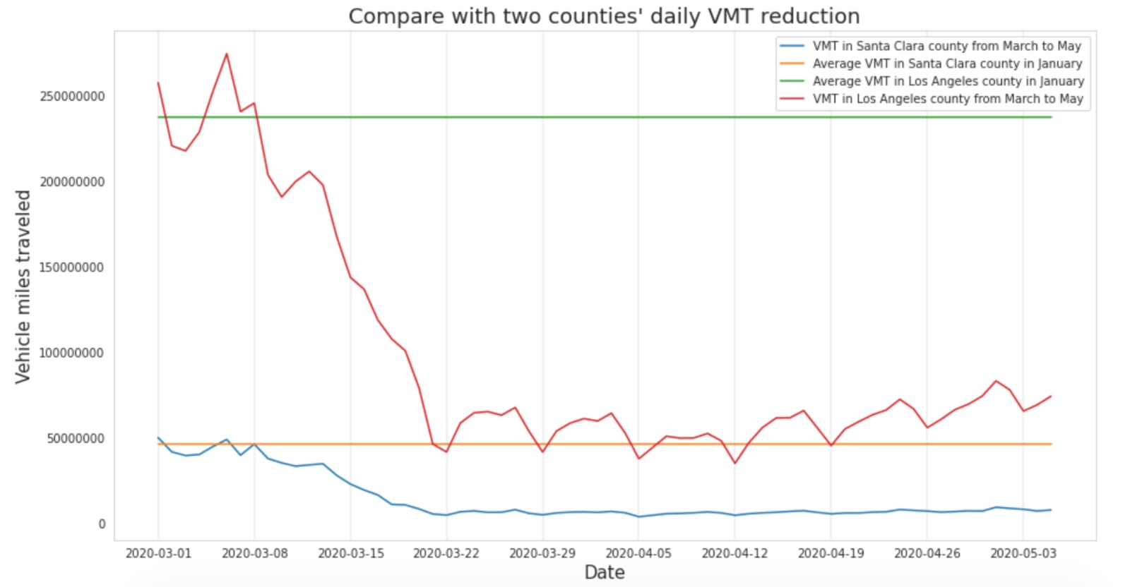
The VMT trend in Santa Clara and Los Angeles County

Slide 15
Effect of COVID-19 on
Fatal Car Accidents
03

Slide 16
Research questions
1. What is the number of confirmed cases, deaths, recoveries, and active cases globally?
2. Prominently affected countries by COVID-19
3. Current situation in the USA
4. Which county in California has the largest vehicle miles traveled? Which county has the shortest?
5. Whether shelter in place order reduced the vehicle miles traveled during the COVID-19 period in California?
6. By how many percent the average vehicle miles traveled in California was dropped after the shelter in place order was implemented?
7. How will the decline in VMT affect the number of fatal accidents in California?
8. How many numbers of people saved?

Slide 17
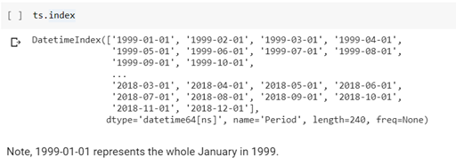
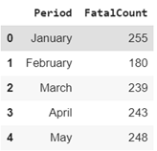
Clean the data

Slide 18
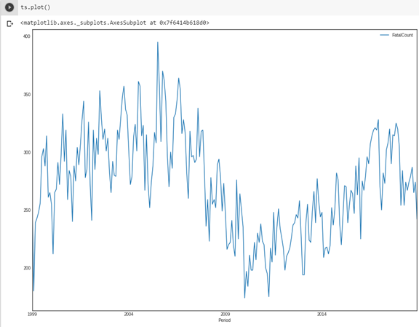
Clean the data (cont.)

Slide 19
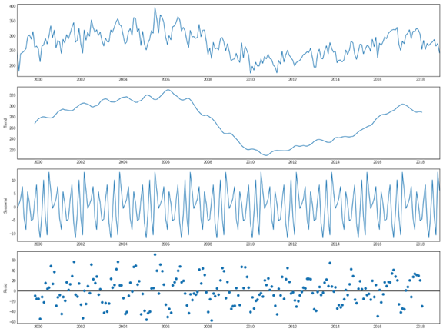
Clean the data (cont.)

Slide 20
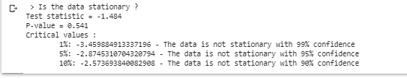
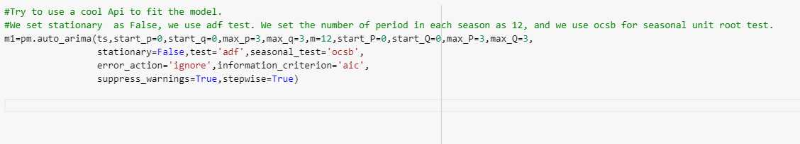
Build the model

Slide 21
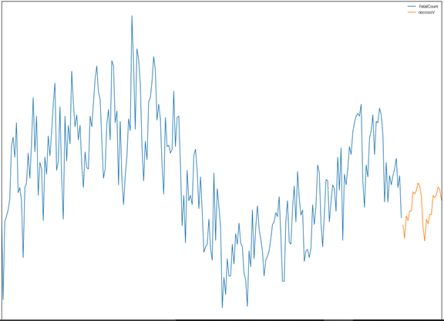
Build the model (cont.)

Slide 22
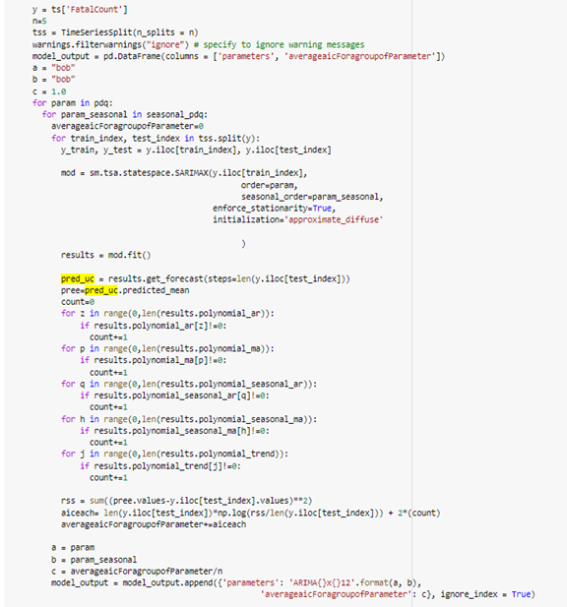
Build the model with cross validation

Slide 23
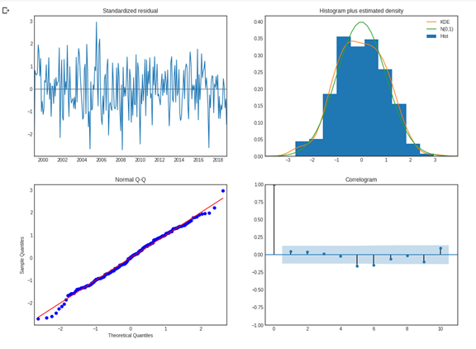
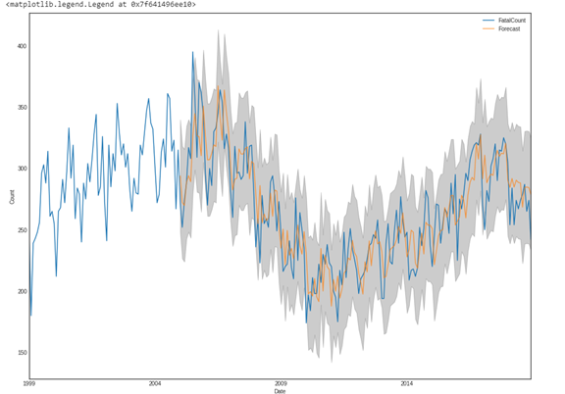
Build the model with cross validation (cont.)

Slide 24
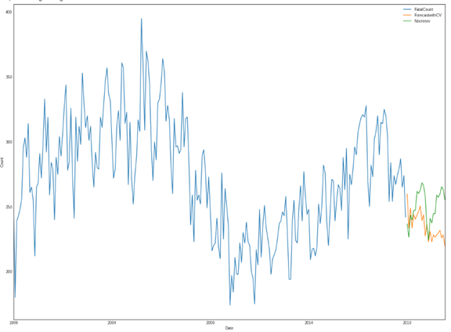
Build the model with cross validation (cont.)

Slide 25
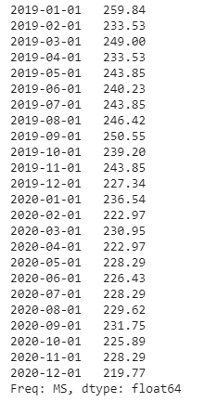
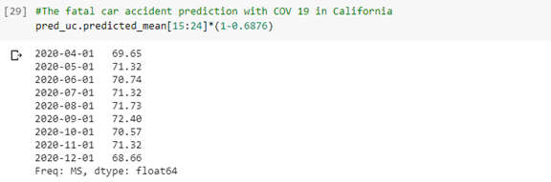
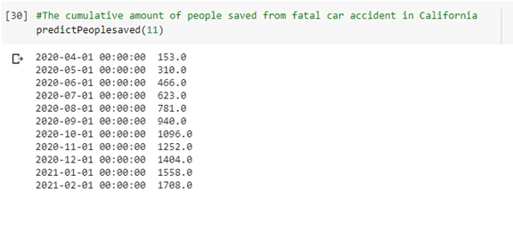
Predicitons

Slide 26
Conclusions
In California state after shelter-in-place implemented, there was a decrease of 68.76% in the average VMT in the initial 18 days.
Another interesting finding is, because of reduction in traffic the number of road accidents has reduced, and this could lead to saving at least 1404 people (from April to December 2020) in California who otherwise would have died in a car accident.
Further improvement(s): might be better to predict the VMT using timeseries regression than simply using miles traveled decrease percentage.
Another improvement might be to find the proper relationship between fatal accident and VMT. To assume a direct proportional relationship might be not convincing.

Slide 27
Thank you! Any questions?

